Slide 1
CRO Dev Task 2
Daniel Ingamells

Slide 2
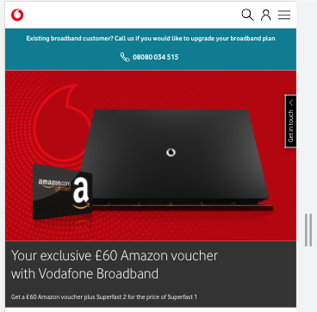
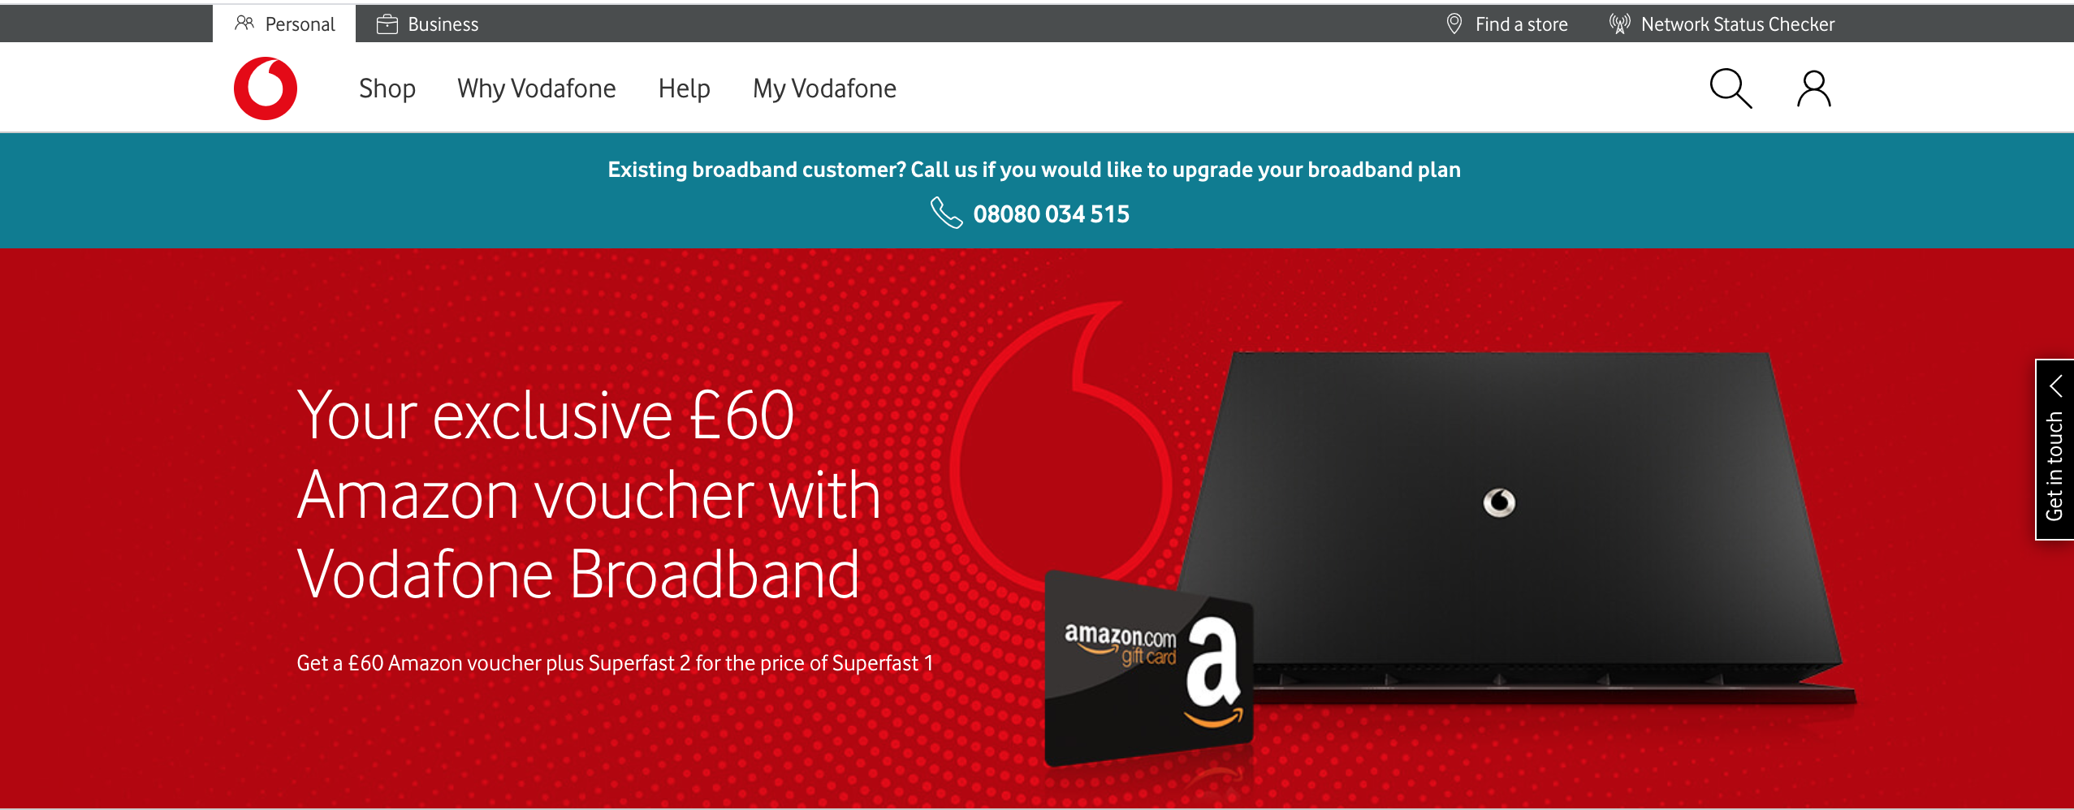
Create a new Hero Banner
1, Create HTML structure of new banner
2, Use CSS + Flexbox and style and layout the new banner (mobile first)
3,Create media queries to scale and change image assets based on breakpoints
*Full code available in slide 5 notes

Slide 3
Hide all the content below the Postcode checker section (except footer)
1, Create CSS to hide all content in the section with ID “#content”
2, Use pseudo selected to avoid hiding the first 4 elements on the page
3, Deploy code:
#content > :not(:nth-child(1)):not(:nth-child(2)):not(:nth-child(3)):not(:nth-child(4)) {
display: none;
}

Slide 4
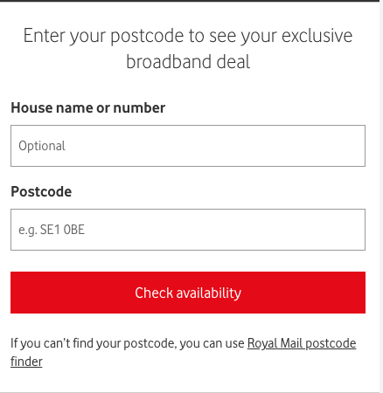
Change Postcode checker section title: Enter your postcode to see your
exclusive broadband deal
1, Create JS to change inner HTML of the title element
2, Deploy JS:
document.querySelectorAll('#content > div.vfuk-Controller__shadow > div > div > div > div:nth-child(1) > h2')[0].innerText = "Enter your postcode to see your exclusive broadband deal"
"Enter your postcode to see your exclusive broadband deal"

Slide 5
Deploy full code
1, Convert all code into JS (in notes)
2, Paste code into Chrome Console to see all changes together
Notes:
var styles = `
#content > :not(:nth-child(1)):not(:nth-child(2)):not(:nth-child(3)):not(:nth-child(4)) {
display: none;
}
.newVF_header {
display: flex;
flex-direction: column-reverse;
}
.hero_left {
min-width: 100%;
-webkit-box-pack: center;
display: flex;
flex: 1;
flex-wrap: wrap;
align-content: center;
justify-content: flex-start;
}
.left_text {
padding: 16px;
max-width: 600px;
z-index: 2;
color: white;
}
.hero_background {
background-image: url(https://cdn.vodafone.co.uk/en/assets/images/medium/IMG_Pro_Broadband_Affiliate_voucher.jpg);
background-repeat: no-repeat;
height: 250px;
background-position: center;
background-size: cover;
}
.hero_image {
background-image: url(https://cdn.vodafone.co.uk/en/assets/images/extralarge/IMG_Pro_Broadband_Affiliate_voucher.jpg);
}
.hero_left {
background-color: #333;
color: #fff;
}
@media screen and (min-width: 601px) {
.hero_background {
height: 450px;
}
}
@media screen and (min-width: 881px) {
.newVF_header {
display: flex;
min-height: 432px;
flex-direction: row;
}
.hero_left {
max-width: 50%;
-webkit-box-pack: center;
display: flex;
flex: 1;
flex-wrap: wrap;
flex-direction: row;
align-content: center;
justify-content: flex-end;
min-width: unset;
}
.left_text {
padding: 64px 64px 64px 32px;
max-width: 600px;
z-index: 2;
color: white;
}
.hero_background {
position: absolute;
height: 100%;
width: 100%;
flex: 1;
}
.hero_image {
background-position: center center;
background-size: cover;
background-image: url(https://cdn.vodafone.co.uk/en/assets/images/extralarge/IMG_Pro_Broadband_Affiliate_voucher.jpg);
position: absolute;
top: 0;
left: 0;
right: 0;
bottom: 0;
z-index: 0;
height: 100%;
width: 100%;
}
}
`
var styleSheet = document.createElement("style")
styleSheet.type = "text/css"
styleSheet.innerText = styles
document.head.appendChild(styleSheet)
document.querySelectorAll('#content > div.vfuk-Controller__shadow > div > div > div > div:nth-child(1) > h2')[0].innerText = "Enter your postcode to see your exclusive broadband deal"
"Enter your postcode to see your exclusive broadband deal"
document.querySelectorAll(".vfuk-Section__section.bg-light1")[0].innerHTML = ` <div class="vfuk-Section__content">
<div class="newVF_header">
<div class="hero_left">
<div class="left_text">
<h1 class="vfuk-Heading__heading vfuk-Heading__heading-2 vfuk-Heading__inherit w-light ">Your exclusive £60 Amazon voucher with Vodafone Broadband</h1>
<p class="vfuk-RawHtmlWrapper__typography ">Get a £60 Amazon voucher plus Superfast 2 for the price of Superfast 1</p>
</div>
</div>
<div class="hero_background">
<div class="hero_image" style="">
</div>
</div>
</div>
</div>`

Slide 6
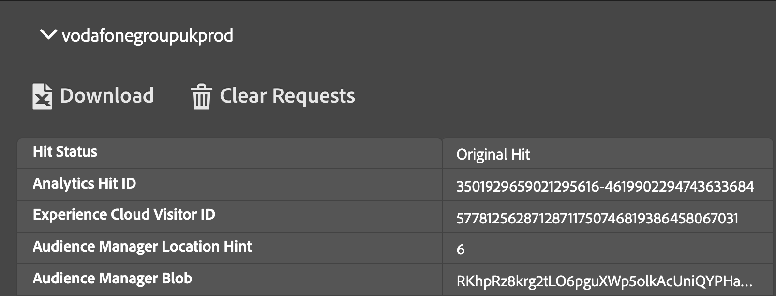



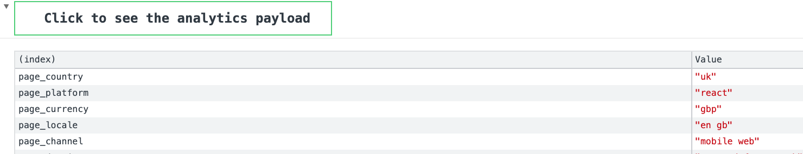
How would you identify if Adobe Target and Adobe Analytics are on this page?

Slide 7
How much of this build can be done using CSS only?
In theory it all could be done using CSS but some of the text replacement would get messy and hard to manage

Slide 8
How much of this build can be done using JavaScript only?
Again it could all be done using JS but breakpoint management and image replacement are easier using CSS

Slide 9
Are there any advantages or disadvantages to using CSS or JavaScript?
JavaScript
CSS
Render blocking
Large function can slow down the page
Browser compatibility issues
Easier to control timings and triggers
Lots of flexibility
Many plugins and API’s that can be utilised
Not as flexible as JS
Cross browser issues with other versions of CSS
Limited functionality
Can use already existing style sheets and styles
Reused code improves site speed
Less complex than JS
Best for layouts and breakpoints (flexbox and media queries)

Slide 10
What is the KPI for this test?
“The Broadband team have requested an A/B test to promote the offer, testing the hypothesis that promoting the offer on the broadband page will increase uptake of the offer”
Primary KPI’s
Broadband sales
Secondary KPI’s
Page CTR
Deal searches (Postcode search)

